Slide 1
Clustering
Partitioning, Hierarchical, Density-Based
&
Grid-Based Methods

Slide 2
Clustering
Clustering is the process of partitioning a set of data objects (or observations) into subsets.
Each subset is a cluster, such that objects in a cluster are similar to one another, yet dissimilar to objects in other clusters..
Clusters: objects within a cluster have high similarity, but are very dissimilar to objects in other clusters.
Dissimilarities and similarities are assessed based on the attribute values describing.
Clustering is known as unsupervised learning because the class label information is not present. For this reason, clustering is a form of learning by observation, rather than learning by examples.

Slide 3
Clustering
Cluster analysis has been widely used in many applications such as:
Information retrieval: document clustering
Land use: Identification of areas of similar land use in an earth observation database
Marketing: Help marketers discover distinct groups in their customer bases, and then use this knowledge to develop targeted marketing programs
City-planning: Identifying groups of houses according to their house type, value, and geographical location
Earth-quake studies: Observed earth quake epicenters should be clustered along continent faults
Climate: understanding earth climate, find patterns of atmospheric and ocean
Economic Science: market research

Slide 4
Major Clustering Approaches
There are many clustering algorithms in the literature. It is difficult to provide a crisp categorization of clustering methods because these categories may overlap so that a method may have features from several categories.
The major fundamental clustering methods can be classified into the following four categories:
Partitioning method:
Construct various partitions and then evaluate them by some criterion, e.g., minimizing the sum of square errors.
Typical methods: k-means, k-medoids
Hierarchical method:
Create a hierarchical decomposition of the set of data (or objects) using some criterion.
Typical methods: Diana, Agnes, BIRCH, CAMELEON

Slide 5
Major Clustering Approaches
There are many clustering algorithms in the literature. It is difficult to provide a crisp categorization of clustering methods because these categories may overlap so that a method may have features from several categories.
The major fundamental clustering methods can be classified into the following four categories:
Density-based method:
Based on connectivity and density functions
Typical methods: DBSACN, OPTICS, DenClue
Grid-based method:
based on a multiple-level granularity structure
Typical methods: STING, WaveCluster, CLIQUE

Slide 6
1. Partitioning Methods
The simplest and most fundamental version of cluster analysis is partitioning, which organizes the objects of a set into several exclusive groups or clusters.
Formally, given a dataset D, of n objects, and k, the number of clusters to form, a partitioning algorithm organizes the objects into k partitions (k ≤ n).
The clusters are formed to optimize an objective partitioning criterion, such as a dissimilarity function based on distance, so that the objects within a cluster are “similar” to one another and “dissimilar” to objects in other clusters in terms of the data set attributes.

Slide 7
1. Partitioning Methods: k-Means
A centroid-based partitioning technique uses the centroid of a cluster C_{i}, to represent that cluster.
Conceptually, the centroid of a cluster is its center point.
The centroid can be defined in various ways such as by the mean or medoid of the objects (or points) assigned to the cluster.
The difference between an object p ϵ C_{i} and c_{i}, the representative of the cluster, is measured by dist(p,c_{i}), where dist(x,y) is the Euclidean distance between two points x and y.

Slide 8
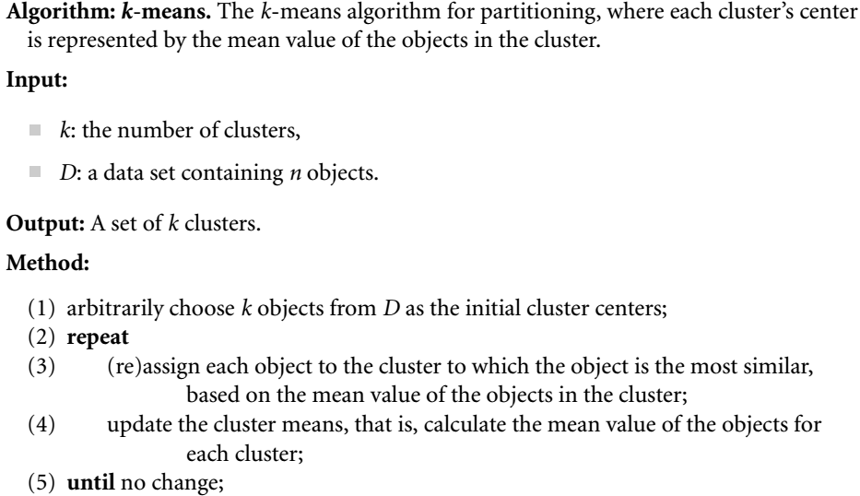
1. Partitioning Methods: k-Means

Slide 9
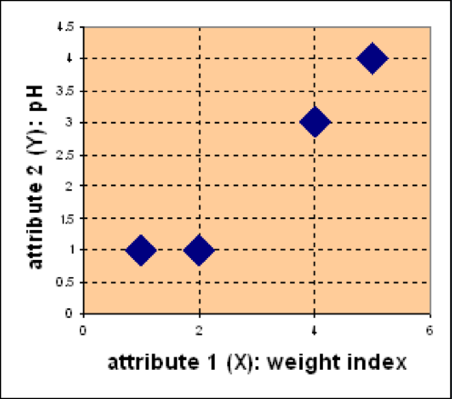
K-means - Example
1. Partitioning Methods: k-Means
Problem:
Suppose we have 4 types of medicines and each has two attributes (pH and weight index). Our goal is to group these objects into K=2 group of medicine.
Medicine | Weight | pH-Index
A | 1 | 1
B | 2 | 1
C | 4 | 3
D | 5 | 4
D
C
A
B

Slide 10
Phale 1st and 2nd row ko ek cluster bana lange
Phir unse saare rows ke point ka eculidian distance nikalege
Jasse A ka phale eculidian distance A,B,C,D se phir B ka A,B,C,D se phir jo ecludian distance kam aaya A se nikalne par B ke bajaye usko A me dal dange or jo ecludian distance kam aaya B se nikalne par A ke bajaye usko B me dal dange
Phir jis bhi cluster me 1 se zyada values h uska centroid nikal lange table ki values se .to hamare cluser ke naye centroid aa jyeage
Phir un centroid se dobara A,B,C,D ka ecludian distance nikalange or yahi process jab tak repeate karange jab tak cluser change hona band na ho jaye

Slide 11
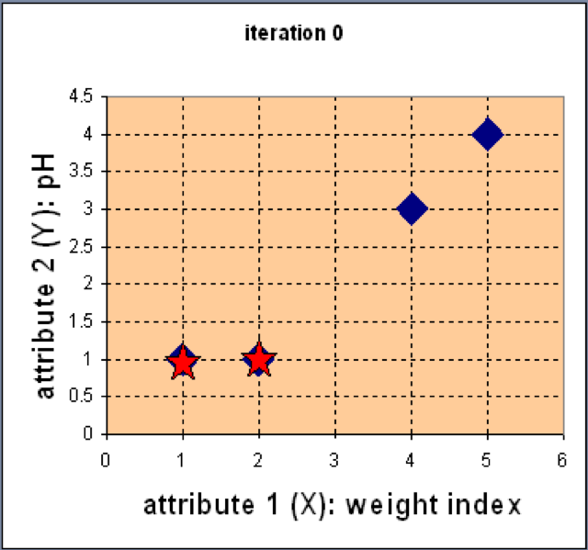
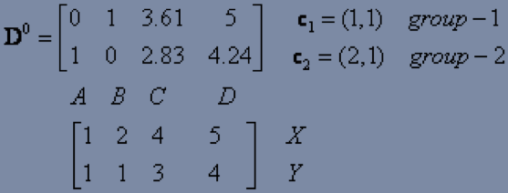
K-means - Example
1. Partitioning Methods: k-Means
Step 1: Use initial seed points for partitioning
Assign each object to the cluster
with the nearest seed point
After seen min distance in matrix
Clusters are
C1=A
C2=B,C,D

Slide 12
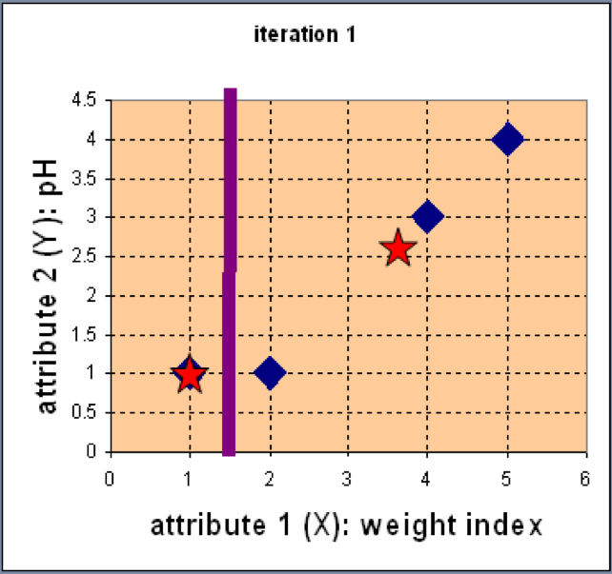
K-means - Example
1. Partitioning Methods: k-Means
Step 2: Compute new centroids of the current partition
Knowing the members of each cluster, now we compute the new centroid of each group based on these new memberships.

Slide 13
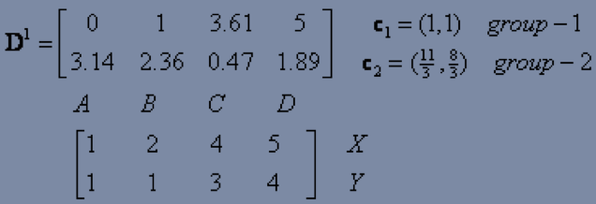
K-means - Example
1. Partitioning Methods: k-Means
Step 2: Renew membership based on new centroids
Compute the distance of all objects to the new centroids
Assign the membership to objects
After seen min distance in matrix
Clusters are
C1=A,B
C2=B,C

Slide 14
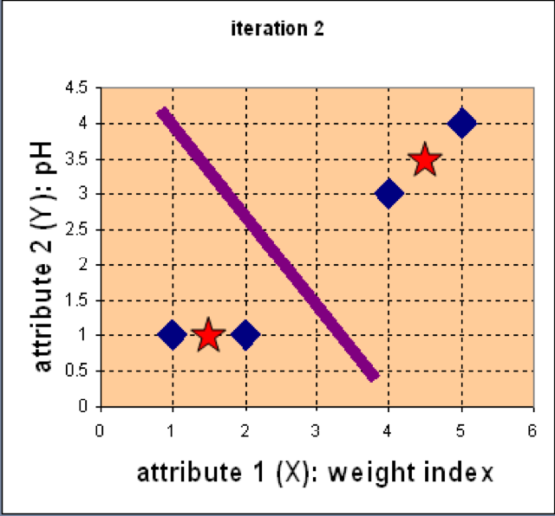
K-means - Example
1. Partitioning Methods: k-Means
Step 3: Repeat the first two steps until its convergence
Knowing the members of each cluster, now we compute the new centroid of each group based on these new memberships.

Slide 15
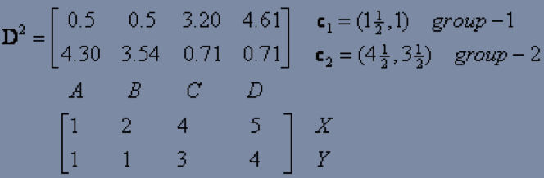
K-means - Example
1. Partitioning Methods: k-Means
Step 3: Repeat the first two steps until its convergence
Compute the distance of all objects to the new centroids
Stop due to no new assignment
Membership in each cluster no longer change
So,here we see clusters not change in this step so we stop here
So,C1=(3/2,1)
C2=(9/2,7/2)
After seen min distance in matrix
Clusters are
C1=A,B
C2=B,C

Slide 16
Strengths of k-means
1. Partitioning Methods: k-Means
Simple: easy to understand and to implement
Efficient: Time complexity: O(tkn), where n is the number of data points, k is the number of clusters, and t is the number of iterations.

Slide 17
Weaknesses of k-means
1. Partitioning Methods: k-Means
The algorithm is only applicable if the mean is defined.
The user needs to specify k.
The algorithm is sensitive to outliers
Outliers are data points that are very far away from other data points.
Outliers could be errors in the data recording or some special data points with very different values.

Slide 18
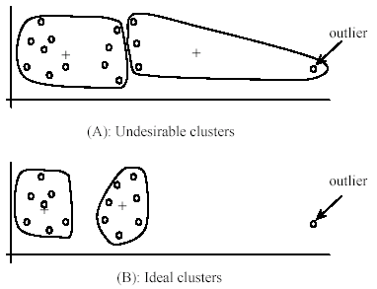
Weaknesses of k-means: Problems with outliers
1. Partitioning Methods: k-Means

Slide 19
Weaknesses of k-means: To deal with outliers
1. Partitioning Methods: k-Means
One method is to remove some data points in the clustering process that are much further away from the centroids than other data points.
To be safe, we may want to monitor these possible outliers over a few iterations and then decide to remove them.
Another method is to perform random sampling. Since in sampling we only choose a small subset of the data points, the chance of selecting an outlier is very small.
Assign the rest of the data points to the clusters by distance or similarity comparison, or classification

Slide 20
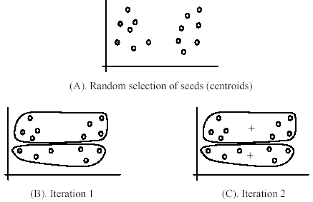
Weaknesses of k-means
1. Partitioning Methods: k-Means
The algorithm is sensitive to initial seeds.

Slide 21
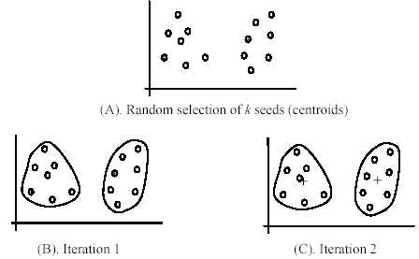
Weaknesses of k-means
1. Partitioning Methods: k-Means
If we use different seeds: good results
There are some methods to help choose good seeds

Slide 22
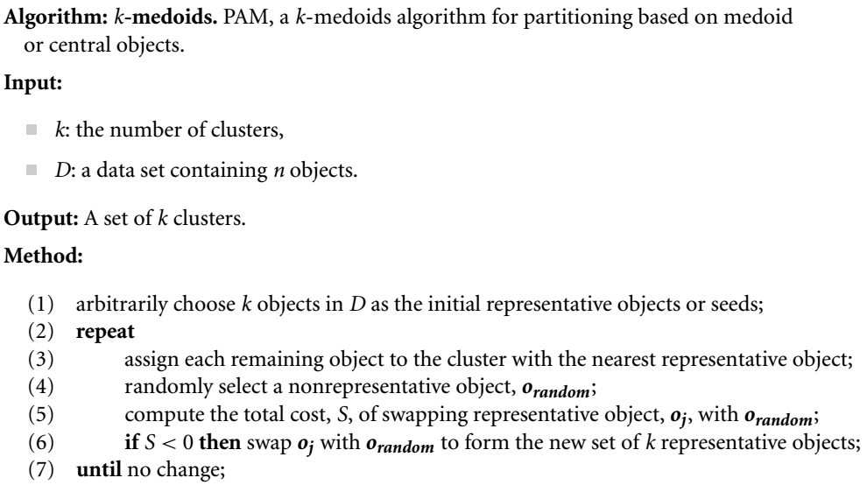
1. Partitioning Methods: k-Medoids
Partitioning Around Medoids (PAM) algorithm is a popular realization of k-medoids clustering.

Slide 23
K-medoids Example
1. Partitioning Methods: k-Medoids
Distances | to X5 | to X9
X1 | 8 | 7
X2 | 5 | 6
X3 | 9 | 8
X4 | 7 | 6
X5 | 0 | 5
X6 | 2 | 3
X7 | 2 | 3
X8 | 3 | 2
X9 | 5 | 0
x10 | 5 | 2
Cost is | 9 | 25
Total cost is 34
X1 | 2 | 6
X2 | 3 | 4
X3 | 3 | 8
X4 | 5 | 7
X5 | 6 | 2
X6 | 6 | 4
X7 | 7 | 3
X8 | 7 | 4
X9 | 8 | 5
x10 | 7 | 6
Assume k=2
Select X5 and X9 as medoids
Here we use Manhattan distance:-|x₂-x₁|+|y₂-y₁|
Those distances are smaller while measure with medoids that make cluster with that medoids
Current clustering: {X2,X5,X6,X7},{X1,X3,X4,X8,X9,X10}

Slide 24
Find manhattan distance of x5 with x2,x6,x7 and x9 with x1,x3,x4,x8,x10
Total cost=5+2+2+7+8+5+2+2=33

Slide 25
K-medoids Example
1. Partitioning Methods: k-Medoids
So, now let us choose some other point to be a medoids from the cluster any of the cluster lets choose cluster 1 instead of X5 (6, 2). Let us randomly choose X1 (2, 6). At one time change only one medoids
Note the new medoid set is: X1(2, 6) and X9(8, 5). Now repeating the same task as earlier:
Replace X5 by X1 | Before( Smallest points) | to X1 | To X9 | Change
X1 | 7 | 0 | 7 | -7
X2 | 5 | 3 | 6 | -2
X3 | 8 | 3 | 8 | -5
X4 | 6 | 4 | 6 | -2
X5 | 0 | 8 | 5 | 5
X6 | 2 | 6 | 3 | 1
X7 | 2 | 8 | 3 | 1
X8 | 2 | 7 | 2 | 0
X9 | 0 | 7 | 0 | 0
x10 | 2 | 5 | 2 | 0
cost |  |  |  | -9
X1 | 2 | 6
X2 | 3 | 4
X3 | 3 | 8
X4 | 5 | 7
X5 | 6 | 2
X6 | 6 | 4
X7 | 7 | 3
X8 | 7 | 4
X9 | 8 | 5
x10 | 7 | 6
Here our cluster is change some points goes first cluster to second and some goes
second to first New cluster after changing medoids
Current clustering: {X1,X2,X3,X4},{X5,X6,X7,X8,X9,X10}

Slide 26
Find manhattan distance of x1 with x2,x3,x4 and x9 with x5,x6,x7,x8,x10
Total cost=3+3+4+5+3+3+2+2=25
Cost of Swapping of medoids x5 with x1
S=Current Total Cost- Previous Total Cost
S=25-33=-8<0
Hence Swapping X5 with x1 is a good idea.
Final Medoids:-{X1},{X9}
C1={X1,X2,X3,X4}
C2={X5,X6,X7,X8,X9,X10}

Slide 27
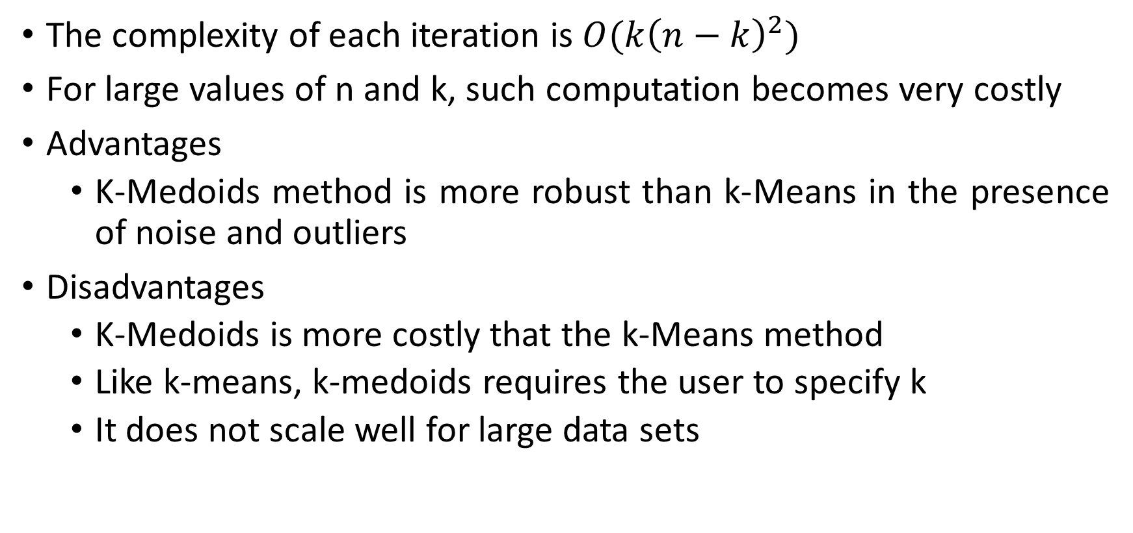
K-medoids Properties
1. Partitioning Methods: k-Medoids
The complexity of each iteration is $O(k{\left(n−k\right)}^{2})$
For large values of n and k, such computation becomes very costly
Advantages
K-Medoids method is more robust than k-Means in the presence of noise and outliers
Disadvantages
K-Medoids is more costly that the k-Means method
Like k-means, k-medoids requires the user to specify k
It does not scale well for large data sets

Slide 28
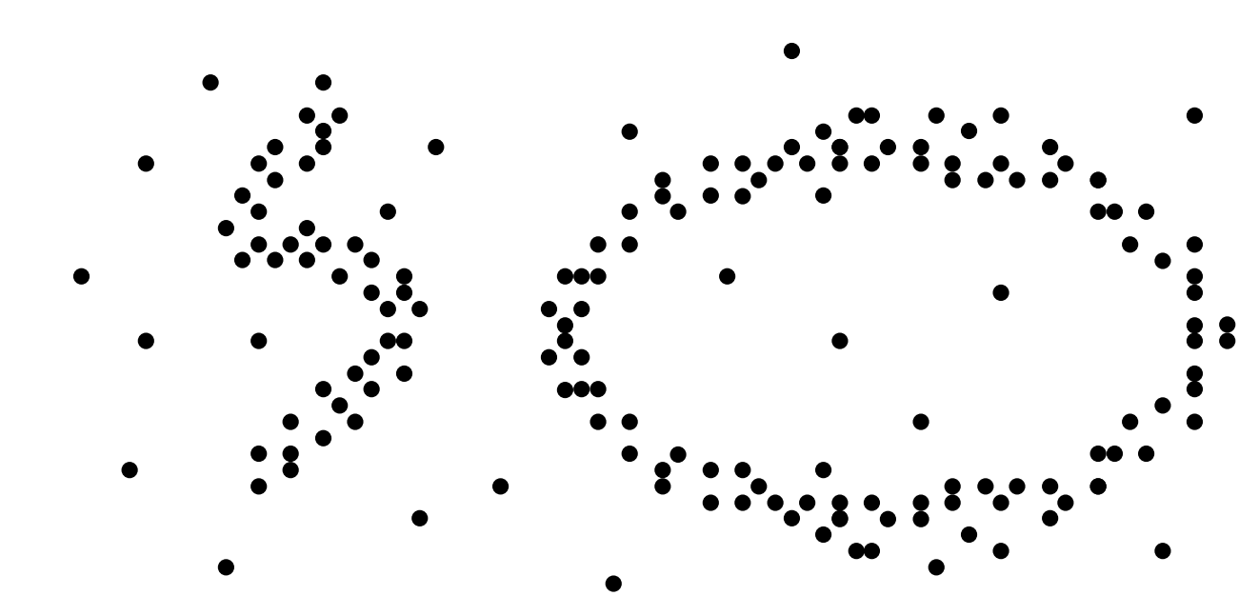
2. Density-Based Methods
Most partitioning methods cluster objects based on the distance between objects. Such methods can find only spherical-shaped clusters and encounter difficulty in discovering clusters of arbitrary shapes.
To find clusters of arbitrary shape, alternatively, we can model clusters as dense regions in the data space, separated by sparse regions.

Slide 29
2. Density-Based Methods
The general idea is to continue growing a given cluster as long as the density (number of objects or data points) in the “neighborhood” exceeds some threshold.
For example, for each data point within a given cluster, the neighborhood of a given radius has to contain at least a minimum number of points. Such a method can be used to filter out noise or outliers and discover clusters of arbitrary shape.

Slide 30
2. Density-Based Methods
Basic density-based clustering methods:
DBSCAN, OPTICS and DENCLUE.
Major features:
Discover clusters of arbitrary shape
Handle noise
One scan
Need density parameters as termination condition

Slide 31
2. Density-Based Methods:DBSCAN
DBSCAN (Density-Based Spatial Clustering of Applications with Noise)
The density of an object o can be measured by the number of objects close to o.
DBSCAN finds core objects, that is, objects that have dense neighborhoods. It connects core objects and their neighborhoods to form dense regions as clusters.

Slide 32
2. Density-Based Methods:DBSCAN
Two parameters:
Eps (ϵ): Maximum radius of the neighbourhood
MinPts: Minimum number of points in an Eps-neighbourhood of that point
N_{Eps}(p): {q belongs to D | dist(p,q) ≤ Eps}
Directly density-reachable: A point p is directly density-reachable from a point q w.r.t. Eps, MinPts if
p belongs to N_{Eps}(q)
core point condition:
|N_{Eps} (q)| ≥ MinPts
p
MinPts = 5
Eps = 1 cm
q

Slide 33
2. Density-Based Methods:DBSCAN
Density-Reachable and Density-Connected
Density-reachable:
A point p is density-reachable from a point q w.r.t. Eps, MinPts if there is a chain of points p₁, …, p_{n}, p₁ = q, p_{n} = p such that p_{i+1} is directly density-reachable from p_{i}
Density-connected
A point p is density-connected to a point q w.r.t. Eps, MinPts if there is a point o such that both, p and q are density-reachable from o w.r.t. Eps and MinPts
p
p₁
q
p
q
o

Slide 34
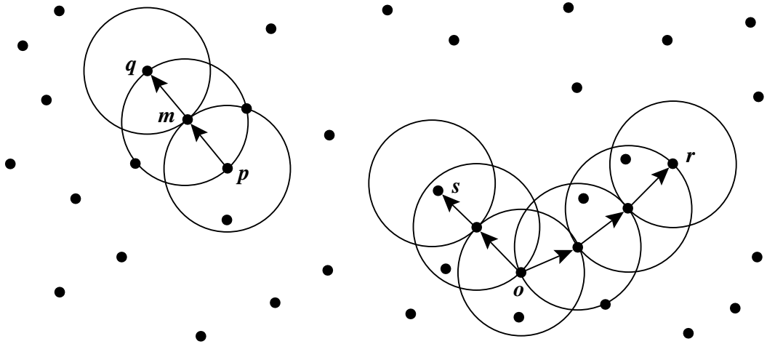
2. Density-Based Methods:DBSCAN
Given ϵ represents the radius of the circles, and MinPts = 3.
Of the labeled points, m,p,o,r are core objects because each is in an ϵ -neighborhood containing at least three points. Object q is directly density-reachable from m. Object m is directly density-reachable from p and vice versa.
Object q is (indirectly) density-reachable from p because q is directly density-reachable from m and m is directly density-reachable from p. However, p is not density-reachable from q because q is not a core object.

Slide 35
2. Density-Based Methods:DBSCAN
Relies on a density-based notion of cluster: A cluster is defined as a maximal set of density-connected points
Discovers clusters of arbitrary shape in spatial databases with noise
Outlier
Border
Eps = 1cm
MinPts = 5
Core

Slide 36
2. Density-Based Methods:DBSCAN
Due to the fixed neighborhood size parameterized by ϵ, the density of a neighborhood can be measured simply by the number of objects in the neighborhood.
To determine whether a neighborhood is dense or not, DBSCAN uses another user-specified parameter, MinPts, which specifies the density threshold of dense regions.
An object is a core object if the ϵ-neighborhood of the object contains at least MinPts objects.
Core objects are the pillars of dense regions.

Slide 37
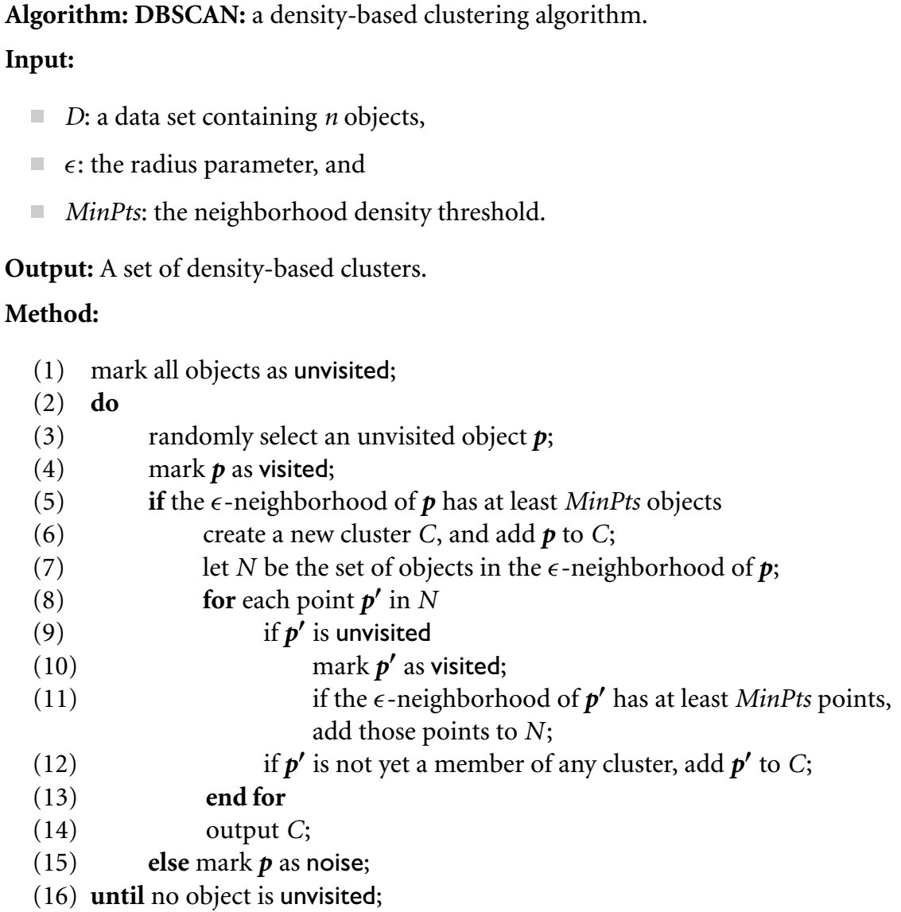

Slide 38
2. Density-Based Methods:DBSCAN
Advantages
Clusters can have arbitrary shape and size
Number of clusters is determined automatically
Can separate clusters from surrounding noise
Disadvantages
Input parameters may be difficult to determine
In some situations very sensitive to input parameter setting

Slide 39
2. Density-Based Methods:OPTICS
DBSCAN required input parameters ϵ and MinPts, however, it is not easy for the user to set these parameters.
Such parameter settings are usually empirically set and difficult to determine, especially for real-world, highdimensional datasets.
Most algorithms are sensitive to these parameter values: Slightly different settings may lead to very different clusterings of the data.
To overcome the difficulty in using one set of global parameters in clustering analysis, a cluster analysis method called OPTICS was proposed.
OPTICS does not explicitly produce a dataset clustering. Instead, it outputs a cluster ordering.

Slide 40
2. Density-Based Methods:OPTICS
Objects in a denser cluster are listed closer to each other in the cluster ordering.
This ordering is equivalent to density-based clustering obtained from a wide range of parameter settings.
Thus, OPTICS does not require the user to provide a specific density threshold.
To construct the different clusterings simultaneously, the objects are processed in a specific order.
This order selects an object that is density-reachable with respect to the lowest ϵ value so that clusters with higher density (lower ϵ) will be finished first.

Slide 41
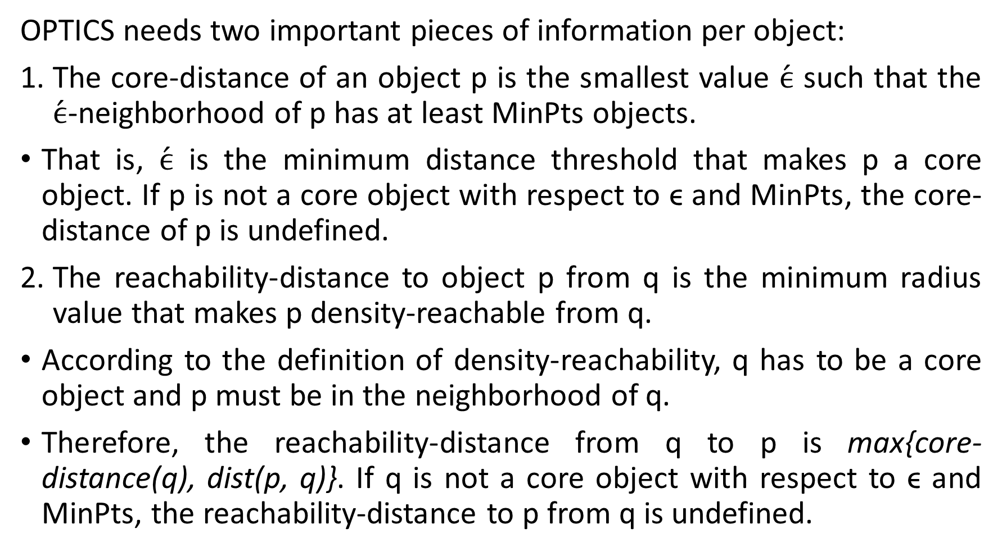
2. Density-Based Methods:OPTICS
OPTICS needs two important pieces of information per object:
The core-distance of an object p is the smallest value $\acute{ϵ}$ such that the $\acute{ϵ}$-neighborhood of p has at least MinPts objects.
That is, $\acute{ϵ}$ is the minimum distance threshold that makes p a core object. If p is not a core object with respect to ϵ and MinPts, the core-distance of p is undefined.
The reachability-distance to object p from q is the minimum radius value that makes p density-reachable from q.
According to the definition of density-reachability, q has to be a core object and p must be in the neighborhood of q.
Therefore, the reachability-distance from q to p is max{core-distance(q), dist(p, q)}. If q is not a core object with respect to ϵ and MinPts, the reachability-distance to p from q is undefined.

Slide 42
3. Grid-Based Methods
Grid-based clustering method takes a space-driven approach by partitioning the embedding space into cells independent of the distribution of the input objects.
The grid-based clustering approach uses a multiresolution grid data structure.
It quantizes the object space into a finite number of cells that form a grid structure on which all of the operations for clustering are performed.
The main advantage of the approach is its fast processing time, which is typically independent of the number of data objects.

Slide 43
3. Grid-Based Methods: CLIQUE
CLIQUE (CLustering In QUEst) is a simple grid-based method for finding densitybased clusters in subspaces.
CLIQUE partitions each dimension into nonoverlapping intervals, thereby partitioning the entire embedding space of the data objects into cells.
It uses a density threshold to identify dense cells and sparse ones. A cell is dense if the number of objects mapped to it exceeds the density threshold.

Slide 44
3. Grid-Based Methods: CLIQUE
CLIQUE is a density-based and grid-based subspace clustering algorithm
Grid-based: It discretizes the data space through a grid and estimates the density by counting the number of points in a grid cell
Density-based: A cluster is a maximal set of connected dense units in a subspace
A unit is dense if the fraction of total data points contained in the unit exceeds the input model parameter.
Subspace clustering: A subspace cluster is a set of neighboring dense cells in an arbitrary subspace. It also discovers some minimal descriptions of the clusters
It automatically identifies subspaces of a high dimensional data space that allow better clustering than original space using the Apriori principle

Slide 45
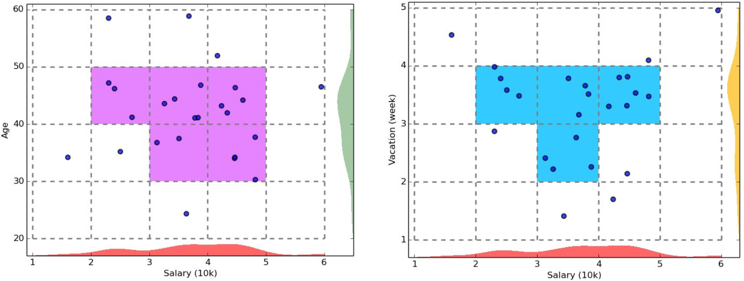
3. Grid-Based Methods: CLIQUE
Bottom-up approach

Slide 46
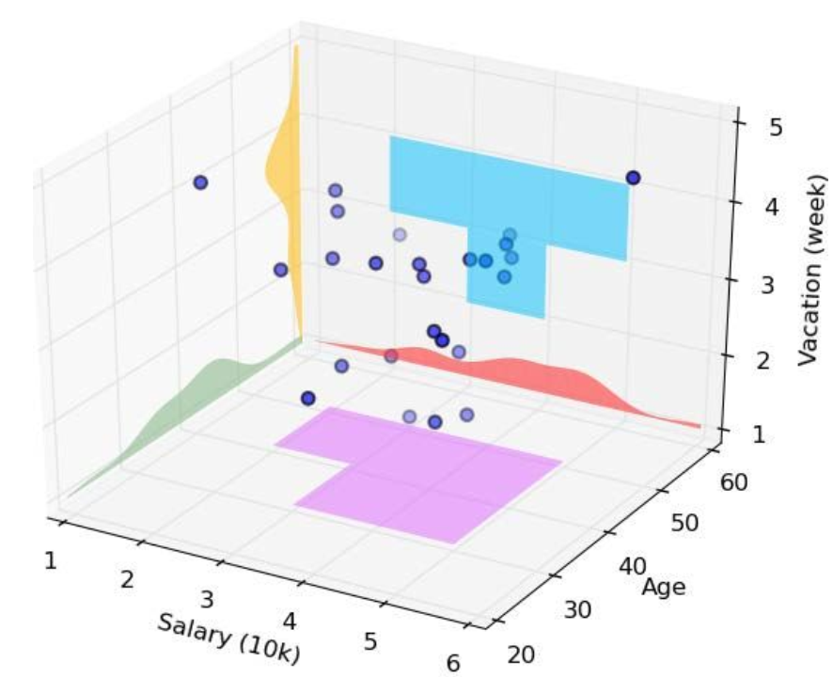
3. Grid-Based Methods: CLIQUE
Bottom-up approach
Apriori principle: If a collection of points S is a cluster in a k-dimensional space, then S is also part of a cluster in any (k-1) dimensional projections of this space

Slide 47
3. Grid-Based Methods: CLIQUE
Major Steps of the CLIQUE Algorithm:
Identify subspaces that contain clusters
Partition the data space and find the number of points that lie inside each cell of the partition
Identify the subspaces that contain clusters using the Apriori principle
Identify clusters
Determine dense units in all subspaces of interests
Determine connected dense units in all subspaces of interests
Generate minimal descriptions for the clusters
Determine maximal regions that cover a cluster of connected dense units for each cluster
Determine minimal cover for each cluster

Slide 48
3. Grid-Based Methods: CLIQUE
Strengths
Automatically finds subspaces of the highest dimensionality as long as high density clusters exist in those subspaces
Insensitive to the order of records in input and does not presume some canonical data distribution
Scales linearly with the size of input and has good scalability as the number of dimensions in the data increases O(Ck + mk)
Simple method and interpretability of results
Weaknesses
As in all grid-based clustering approaches, the quality of the results crucially depends on the
appropriate choice of the number and width of the partitions and grid cells

Slide 49
4. Hierarchical
A hierarchical clustering method works by grouping data objects into a hierarchy or “tree” of clusters.

Slide 50
4. Hierarchical
Agglomerative versus Divisive Hierarchical Clustering:
An agglomerative hierarchical clustering method uses a bottom-up strategy.
It typically starts by letting each object form its own cluster and iteratively merges clusters into larger and larger clusters, until all the objects are in a single cluster or certain termination conditions are satisfied.
A divisive hierarchical clustering method employs a top-down strategy.
It starts by placing all objects in one cluster, which is the hierarchy’s root.

Slide 51
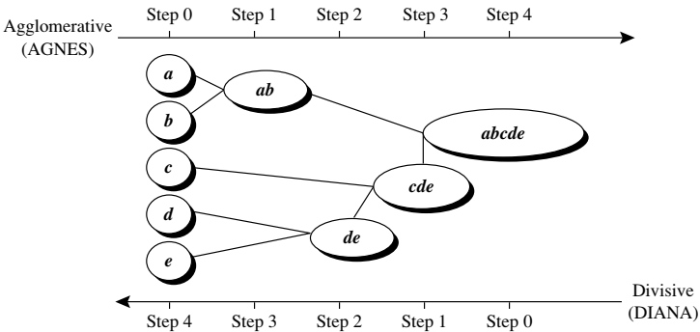
4. Hierarchical
Agglomerative versus Divisive Hierarchical Clustering:
Initialization:
All objects stay in one cluster
Iteration:
Select a cluster and split it into
two sub clusters
Until each leaf cluster contains
only one object
Initialization:
Each object is a cluster
Iteration:
Merge two clusters which are
most similar to each other;
Until all objects are merged
into a single cluster

Slide 52
4. Hierarchical
Dendrogram representation for hierarchical clustering of data objects {a,b,c,d,e}
Each node on the tree is a cluster; each leaf node is a singleton cluster

Slide 53
How to Merge Clusters?
4. Hierarchical
How to measure the distance between clusters?
Single-link
Complete-link
Average-link
Centroid distance
Distance?
Hint: Distance between clusters is usually defined on the basis of distance between objects.

Slide 54
How to Define Inter-Cluster Distance
4. Hierarchical
Single-link
Complete-link
Average-link
Centroid distance
The distance between two clusters is represented by the distance of the closest pair of data objects belonging to different clusters.

Slide 55
How to Define Inter-Cluster Distance
4. Hierarchical
Single-link
Complete-link
Average-link
Centroid distance
The distance between two clusters is represented by the distance of the farthest pair of data objects belonging to different clusters.

Slide 56
How to Define Inter-Cluster Distance
4. Hierarchical
Single-link
Complete-link
Average-link
Centroid distance
The distance between two clusters is represented by the average distance of all pairs of data objects belonging to different clusters.

Slide 57
How to Define Inter-Cluster Distance
4. Hierarchical
×
×
m_{i},m_{j} are the means of C_{i}, C_{j}, respectively
Single-link
Complete-link
Average-link
Centroid distance
The distance between two clusters is represented by the distance between the means of the cluters.

Slide 58
Cluster Distance Measures
4. Hierarchical
Example: Given a data set of five objects characterized by a single continuous feature, assume that there are two clusters: C1: {a, b} and C2: {c, d, e}.
1. Calculate the distance matrix. 2. Calculate three cluster distances between C1 and C2.
a | b | c | d | e
1 | 2 | 4 | 5 | 6
Single link:
Complete link:
Average:
 | a | b | c | d | e
a | 0 | 1 | 3 | 4 | 5
b | 1 | 0 | 2 | 3 | 4
c | 3 | 2 | 0 | 1 | 2
d | 4 | 3 | 1 | 0 | 1
e | 5 | 4 | 2 | 1 | 0

Slide 59
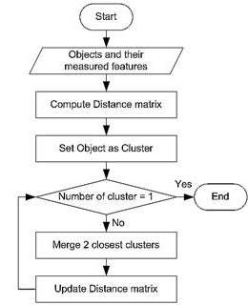
Agglomerative Algorithm
4. Hierarchical
The Agglomerative algorithm is carried out in three steps:
Convert all object features into a distance matrix
Set each object as a cluster (thus if we have N objects, we will have N clusters at the beginning)
Repeat until number of cluster is one (or known # of clusters)
Merge two closest clusters
Update “distance matrix”

Slide 60
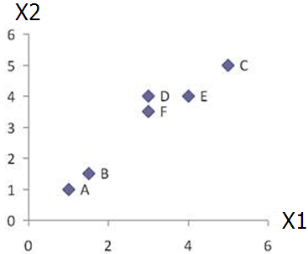
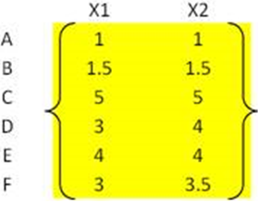
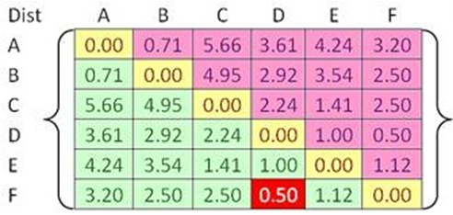
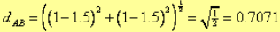
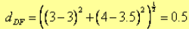
4. Hierarchical
Problem: clustering analysis with agglomerative algorithm
data matrix
Euclidean distance
distance matrix

Slide 61
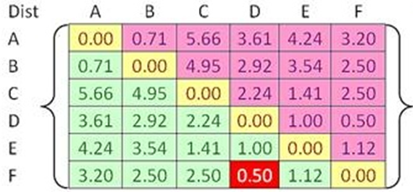
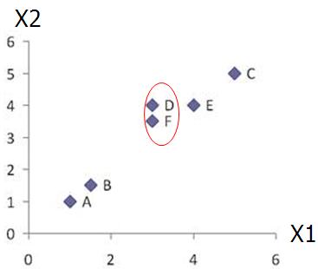
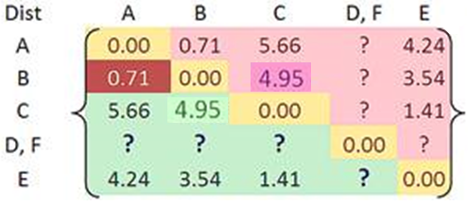
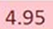
4. Hierarchical
Merge two closest clusters (iteration 1)

Slide 62
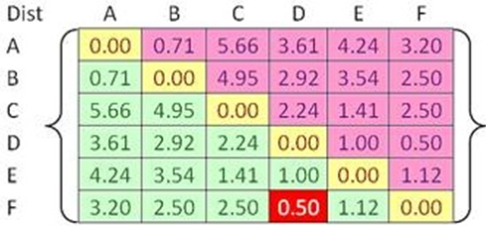
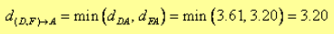
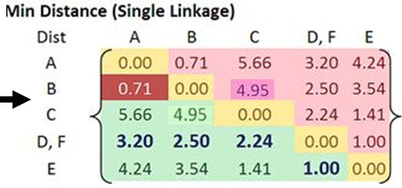
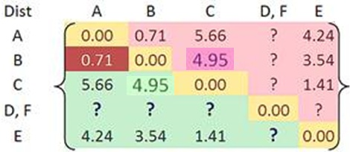
4. Hierarchical
Update distance matrix (iteration 1)

Slide 63
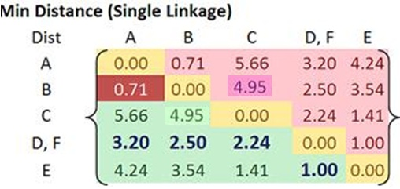
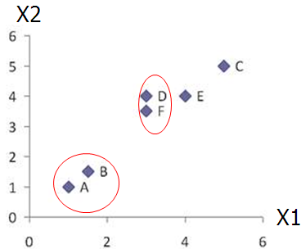
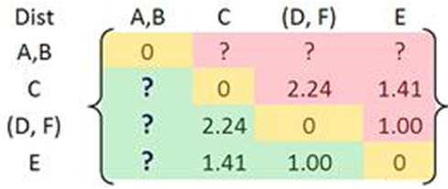
4. Hierarchical
Merge two closest clusters (iteration 2)

Slide 64
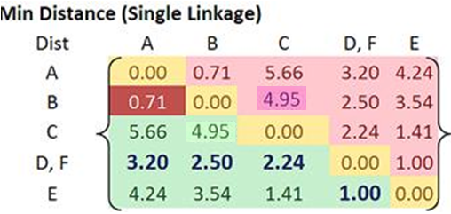
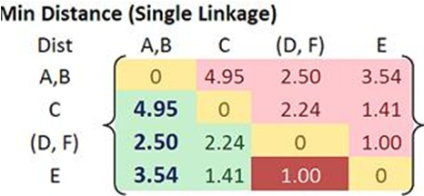

4. Hierarchical
Update distance matrix (iteration 2)

Slide 65
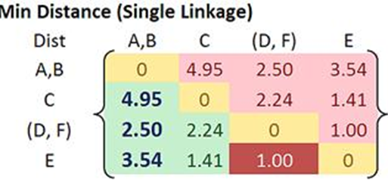
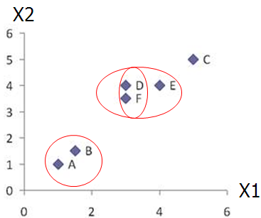
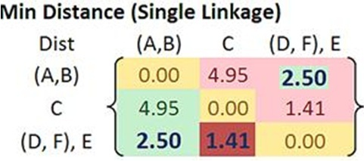
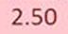
4. Hierarchical
Merge two closest clusters/update distance matrix (iteration 3)

Slide 66
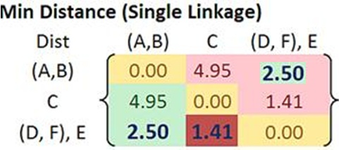
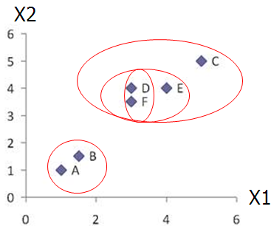
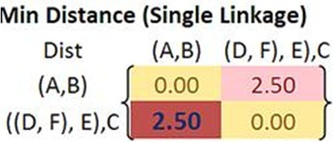
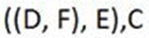
4. Hierarchical
Merge two closest clusters/update distance matrix (iteration 4)

Slide 67
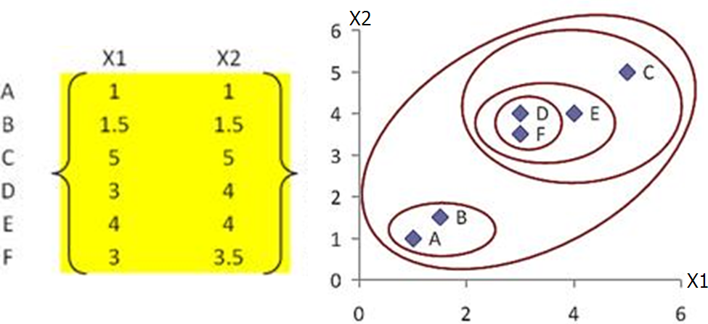
4. Hierarchical
Final result (meeting termination condition)

Slide 68
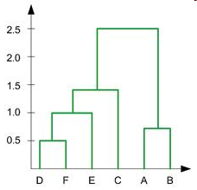
4. Hierarchical
Dendrogram tree representation
In the beginning we have 6
clusters: A, B, C, D, E and F
We merge clusters D and F into
cluster (D, F) at distance 0.50
We merge cluster A and cluster B
into (A, B) at distance 0.71
We merge clusters E and (D, F)
into ((D, F), E) at distance 1.00
We merge clusters ((D, F), E) and C
into (((D, F), E), C) at distance 1.41
We merge clusters (((D, F), E), C)
and (A, B) into ((((D, F), E), C), (A, B))
at distance 2.50
The last cluster contain all the objects,
thus conclude the computation
6
lifetime
5
4
3
2
object

Slide 69
4. Hierarchical
Dendrogram tree representation
For a dendrogram tree, its horizontal axis indexes all objects in a given data set, while its vertical axis expresses the lifetime of all possible cluster formation.
The lifetime of a cluster (individual cluster) in the dendrogram is defined as a distance interval from the moment that the cluster is created to the moment that it disappears by merging with other clusters.
6
lifetime
5
4
3
2
object

Slide 70
Which Distance Measure is Better?
4. Hierarchical
Each method has both advantages and disadvantages; application-dependent, single-link and complete-link are the most common methods
Single-link
Can find irregular-shaped clusters
Sensitive to outliers, suffers the so-called chaining effects
In order to merge two groups, only need one pair of points to be close, irrespective of all others. Therefore clusters can be too spread out, and not compact enough
Average-link, and Centroid distance
Robust to outliers
Tend to break large clusters

Slide 71
4. Hierarchical: AGNES
AGNES : AGglomerative NESting
Use single-link method
Merge nodes that have the least dissimilarity
Eventually all objects belong to the same cluster

Slide 72
4. Hierarchical: BIRCH
BIRCH: Balanced Iterative Reducing and Clustering using Hierarchies.
BIRCH uses the notions of clustering feature to summarize a cluster, and clustering feature tree (CF-tree) to represent a cluster hierarchy.
These structures help the clustering method achieve good speed and scalability in large or even streaming databases, and also make it effective for incremental and dynamic clustering of incoming objects.

Slide 73
BIRCH: Key Components
4. Hierarchical: BIRCH
Clustering Feature (CF)
Summary of the statistics for a given cluster: the 0-th, 1st and 2nd moments of the cluster from the statistical point of view
A CF entry has sufficient information to calculate the centroid, radius, diameter and many other distance measures
Additively theorem allows us to merge sub-clusters incrementally
CF-Tree
height-balanced tree
two parameters:
number of entries in each node
The diameter of all entries in a leaf node
Leaf nodes are connected via prev and next pointers

Slide 74
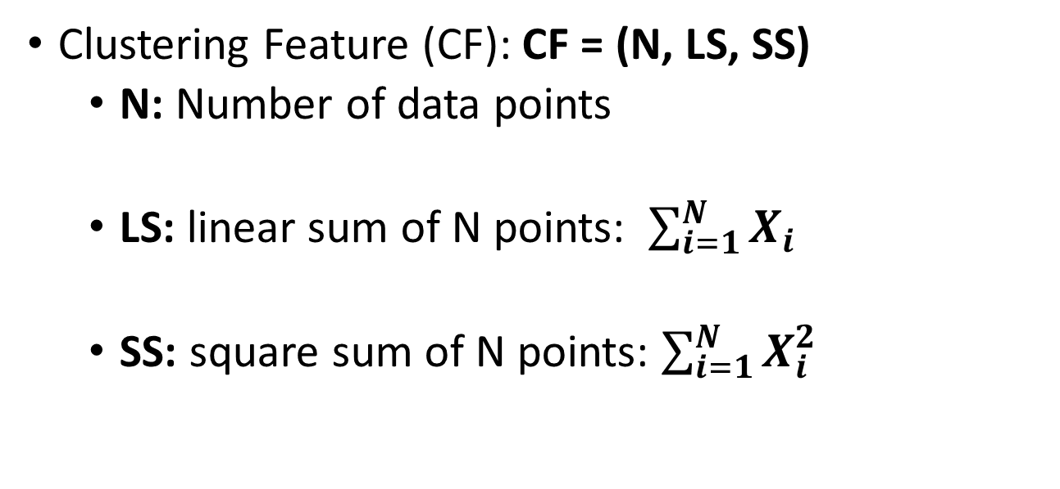
Clustering Feature
4. Hierarchical: BIRCH
Clustering Feature (CF): CF = (N, LS, SS)
N: Number of data points
LS: linear sum of N points: $\sum_{i=1}^{N}{X_{i}}$
SS: square sum of N points: $\sum_{i=1}^{N}{X_{i}^{2}}$

Slide 75

Distance Measures:
4. Hierarchical: BIRCH
Given a cluster with data points ,
Centroid:
$$X_{0}=\frac{\sum_{i=1}^{N}{X_{i}}}{N}=\frac{LS}{N}$$
Radius: average distance from member points to centroid
Diameter: average pair-wise distance within a cluster

Slide 76


Clustering Feature:
4. Hierarchical: BIRCH
Suppose cluster C₁ has CF₁=(N₁, LS₁ ,SS₁), cluster C₂ has CF₂ =(N₂,LS₂,SS₂)
If we merge C₁ with C₂, the CF for the merged cluster C is
Why CF?
Summarized info for single cluster
Summarized info for two clusters
Additive theorem
CF1= 〈3, (2+3+4 , 5+2+3), ($2^{2}+3^{2}+4^{2} , 5^{2}+2^{2}+3^{2}$)〉
= 〈3, (9,10), (29 ,38)〉
CF3=CF1+CF2= 〈3+3, (9+35, 10+36), (29+417 , 38+440)〉 = 〈6, (44,46), (446 ,478)〉

Slide 77
CF-Tree:
4. Hierarchical: BIRCH
A CF tree is a height-balanced tree with two parameters: branching factor B and threshold T.
Branching factor:
B : Each non-leaf node contains at most B entries of the form [CF_{i}, child_{i}] , where I = 1, 2, …, B, and child_{i} is a pointer to its i-th child node. CF_{i} Is the CF of the sub-cluster represented by the child_{i}.
L : A leaf node contains at most L entries, each of the form [CF_{i}], where I = 1, 2, …, L. In addition, each leaf node has two pointers, “prev” and “next” which are used to chain all leaf node together
A leaf node also represent a cluster made up of all the sub-clusters represented by its entries.
Threshold T:
The diameter (alternatively, the radius) of all entries in a leaf node is at most T
Leaf nodes are connected via prev and next pointers

Slide 78
Example of CF Tree:
4. Hierarchical: BIRCH
Root
B = 6
L = 5
CF₁
CF₂
CF₃
CF₆
child₁
child₂
child₃
child₆
Non-leaf node
CF₉
CF₁₀
CF₁₁
CF₁₃
child₁
child₂
child₃
child₅
Leaf node
Leaf node
prev
CF₉₀
CF₉₁
CF₉₄
next
prev
CF₉₅
CF₉₆
CF₉₈
next

Slide 79

CF Tree Insertion:
4. Hierarchical: BIRCH
Given entry “Ent”, it proceeds as below:
Identifying the appropriate leaf
recursively descending the CF tree and choosing the closest child node according to a chosen distance metric
Modifying the leaf:
When it reaches a leaf node, it finds the closest leaf entry, say $L_{i}$, and then test whether $L_{i}$ can absorb the node without violating the threshold. If so, the CF vector for $L_{i}$ is updated to reflect this.
If not, a new entry for “Ent” is added to the leaf. If there is no room, split the node
Modifying the path:
update CF information up the path.

Slide 80



Example:
4. Hierarchical: BIRCH
$$x_{1}$$ | 0.5
$$x_{2}$$ | 0.25
$$x_{3}$$ | 0
$$x_{4}$$ | 0.65
$$x_{5}$$ | 1
$$x_{6}$$ | 1.4
$$x_{7}$$ | 1.1
Enter the first data $x_{1}$
The root node is initialized with the CF values of the first data value
A new leaf Leaf1 is created, and BIRCH assigns the first record $x_{1}$ to Leaf1
Leaf1 contains only one record and hence the radius is zero and thus less than T=0.15
Root-Node 0
CF1: n=1, Ls=0.5, SS = 0.25
T = 0.15
L = 2
B = 2
Leaf1:R=0
$x_{1}$=0.5

Slide 81




Example:
4. Hierarchical: BIRCH
$$x_{1}$$ | 0.5
$$x_{2}$$ | 0.25
$$x_{3}$$ | 0
$$x_{4}$$ | 0.65
$$x_{5}$$ | 1
$$x_{6}$$ | 1.4
$$x_{7}$$ | 1.1
The second data value $x_{2}$=0.25 is entered.
BIRCH tentatively passes $x_{2}$=0.25 to Leaf1.
The radius of Leaf1 is now R = 0.126 < T = 0.15, so $x_{2}$ is assigned to Leaf1.
LS=0.5+0.25=0.75
SS=((0.5)²+(0.75)²)=0.313
Root-Node 0
CF1: n=1, Ls=0.5, SS = 0.25
Root-Node 0
CF1: n=2, Ls=0.75, SS = 0.313
T = 0.15
L = 2
B = 2
Here we take only one data point so its radius is zero
Leaf1:R=0
Leaf1:R=0.126
$x_{1}$=0.5
$x_{1}$=0.5, $x_{2}$= 0.25
R

Slide 82




Example:
4. Hierarchical: BIRCH
The third data value $x_{3}=0$ is entered.
BIRCH tentatively passes $x_{3}=0$ to Leaf1.
However, the radius of Leaf1 now increases to $R=0.205>T=0.15$. The Threshold value T=0.15 is exceeded, so x3 is not assigned to Leaf1.
Instead, a new leaf is initialized, called Leaf2, containing x3 only. Node splitting is done by choosing the farthest pair of entries as seeds, and redistributing the remaining entries based on the closest criteria
Root-Node 0
$$x_{1}$$ | 0.5
$$x_{2}$$ | 0.25
$$x_{3}$$ | 0
$$x_{4}$$ | 0.65
$$x_{5}$$ | 1
$$x_{6}$$ | 1.4
$$x_{7}$$ | 1.1
CF1: n=2, Ls=0.75, SS = 0.313
CF2: n=1, Ls=0.0, SS = 0
T = 0.15
L = 2
B = 2
Leaf1:R=0.126
Leaf2:R=0
$x_{1}$=0.5, $x_{2}$= 0.25
$x_{3}$=0

Slide 83

Example:
4. Hierarchical: BIRCH
The fourth data value $x_{4}=0.65$ is entered. BIRCH compares $x_{4}$ to the locations of CF1 and CF2.
The location is measured by $\overline{x}=\frac{LS}{n}$. We have ${\overline{x}}_{CF_{1}}=\frac{0.75}{2}=0.375$ and ${\overline{x}}_{CF_{2}}=\frac{0}{1}=0$
The data point $x_{4}=0.65$ is thus closer to CF1 than to CF2. Thus, BIRCH tentatively passes x4 to CF1.
The radius of CF1 now increases to R=0.166>T=0.15. The Threshold value T=0.15 is exceeded, so $x_{4}$ is not assigned to CF1. Instead, we would like to initialize a new leaf.
However, B=2 means that we cannot have three leaf's in a leaf node. We must therefore split the root node into (i) Node1, which has as its children Leaf1 and Leaf2, and (ii) Node2, whose only leaf Leaf3 contains only $x_{4}$

Slide 84




Example:
T = 0.15
L = 2
B = 2
$$x_{1}$$ | 0.5
$$x_{2}$$ | 0.25
$$x_{3}$$ | 0
$$x_{4}$$ | 0.65
$$x_{5}$$ | 1
$$x_{6}$$ | 1.4
$$x_{7}$$ | 1.1
4. Hierarchical: BIRCH
Root-Node 0
CF12: n=3, Ls=0.75, SS = 0.313
CF3: n=1, Ls=0.65, SS = 0.423
Node 1
Node 2
CF1: n=2, Ls=0.75, SS = 0.313
CF2: n=1, Ls=0.0, SS = 0
CF3: n=1, Ls=0.65, SS = 0.423
Leaf1:R=0.126
Leaf2:R=0.
Leaf3:R=0.
$x_{1}$=0.5, $x_{2}$= 0.25
$x_{3}$=0
$x_{4}$=0.65

Slide 85

Example:
4. Hierarchical: BIRCH
The fifth data value $x_{5}=1$ is entered.
BIRCH compares $x_{5}=1$ with the location of $CF_{12}$ and $CF_{3}$.
We have $x_{CF_{12}}={0.75}/3=0.25$ and $x_{CF_{3}}=0.65∕1=0.65$. The data point $x_{5}=1$ is thus closer to $CF_{3}$ than to $CF_{12}$.
BIRCH passes $x_{5}$ to $CF_{3}$. The radius of $CF_{3}$ now increases to $R=0.175>T=0.15$, so $x_{5}$ cannot be assigned to $CF_{3}$.
Instead, a new leaf in leaf node Leaf4 is initialized, with $CF, CF_{4}$, containing $x_{5}$ only. The summary statistics for $CF_{34}$ are updated.

Slide 86





T = 0.15
L = 2
B = 2
$$x_{1}$$ | 0.5
$$x_{2}$$ | 0.25
$$x_{3}$$ | 0
$$x_{4}$$ | 0.65
$$x_{5}$$ | 1
$$x_{6}$$ | 1.4
$$x_{7}$$ | 1.1
4. Hierarchical: BIRCH
Example:
Root-Node 0
CF12: n=3, Ls=0.75, SS = 0.313
CF34: n=2, Ls=1.65, SS = 1.423
Node 1
Node 2
CF1: n=2, Ls=0.75, SS = 0.313
CF2: n=1, Ls=0.0, SS = 0
CF3: n=1, Ls=0.65, SS = 0.423
CF4: n=1, Ls=1, SS = 1
Leaf1:R=0.126
Leaf2:R=0.
Leaf3:R=0.
Leaf4:R=0.
$x_{1}$=0.5, $x_{2}$= 0.25
$x_{3}$=0
$x_{4}$=0.65
$x_{5}$=1
86

Slide 87

Example:
4. Hierarchical: BIRCH
The sixth data value $x_{6}=1.4$ is entered. At the root node, BIRCH compares $x_{6}=1.4$ with the location of $CF_{12}$ and $CF_{34}$.
We have $x_{CF_{12}}=0.75∕3=0.25$and $x_{CF_{34}}=1.65∕2=0.825$. The data point $x_{6}=1.4$ is thus closer to $CF_{34}$, and BIRCH passes $x_{6}$ to $CF_{34}$.
The record descends to Node2, and BIRCH compares $x_{6}=1.4$ with the location of $CF_{3}$ and $CF_{4}$.
We have $x_{CF_{3}}=0.65$ and $x_{CF_{4}}=1$. The data point $x_{6}=1.4$ is thus closer to $CF_{4}$than to $CF_{3}$. BIRCH tentatively passes $x_{6}$ to $CF_{4}$.
The radius of $CF_{4}$ now increases to $R=0.2>T=0.15$. The Threshold value T=0.15 is exceeded, so $x_{6}$ is not assigned to $CF_{4}$. But the branching factor B=2 means that we may have at most two leaf nodes branching off of any non-leaf node. Therefore, we will need a new set of non-leaf nodes, Node2.1 and Node2.2, branching off from Node2.
Node2.1 contains $CF_{3}$ and $CF_{4}$, while Node2.2 contains the desired new $CF_{5}$ and the new leaf node Leaf5 as its only child, containing only the information from $x_{6}$.

Slide 88






T = 0.15
L = 2
B = 2
$$x_{1}$$ | 0.5
$$x_{2}$$ | 0.25
$$x_{3}$$ | 0
$$x_{4}$$ | 0.65
$$x_{5}$$ | 1
$$x_{6}$$ | 1.4
$$x_{7}$$ | 1.1
4. Hierarchical: BIRCH
Example:
Root-Node 0
CF12: n=3, Ls=0.75, SS = 0.313
CF345: n=3, Ls=3.05, SS = 3.393
Node 1
Node 2
CF1: n=2, Ls=0.75, SS = 0.313
CF2: n=1, Ls=0.0, SS = 0
CF34: n=2, Ls=1.65, SS = 1.423
CF5: n=1, Ls=1.4, SS = 1.96
Node 2.1
Node 2.2
Leaf1:R=0.126
Leaf2:R=0.
CF3: n=1, Ls=0.65, SS = 0.423
CF4: n=1, Ls=1, SS = 1
CF5: n=1, Ls=1.4, SS = 1.96
$x_{1}$=0.5, $x_{2}$= 0.25
$x_{3}$=0
Leaf3:R=0.
Leaf4:R=0.
Leaf5:R=0.
$x_{4}$=0.65
$x_{5}$=1
$x_{6}$=1.4
88

Slide 89

T = 0.15
L = 2
B = 2
$$x_{1}$$ | 0.5
$$x_{2}$$ | 0.25
$$x_{3}$$ | 0
$$x_{4}$$ | 0.65
$$x_{5}$$ | 1
$$x_{6}$$ | 1.4
$$x_{7}$$ | 1.1
4. Hierarchical: BIRCH
Example:
Root-Node 0
CF12: n=3, Ls=0.75, SS = 0.313
CF345: n=4, Ls=4.15, SS = 4.212
Node 1
Node 2
CF1: n=2, Ls=0.75, SS = 0.313
CF2: n=1, Ls=0.0, SS = 0
CF34: n=3, Ls=2.75, SS = 2.252
CF5: n=1, Ls=1.4, SS = 1.96
Node 2.1
Node 2.2
Leaf1:R=0.126
Leaf2:R=0.
CF3: n=1, Ls=0.65, SS = 0.423
CF4: n=2, Ls=2.1, SS = 2.21
CF5: n=1, Ls=1.4, SS = 1.96
$x_{1}$=0.5, $x_{2}$= 0.25
$x_{3}$=0
Leaf3:R=0.
Leaf4:R=0.05
Leaf5:R=0.
$x_{4}$=0.65
$x_{5}$=1 $x_{7}$=1.1
$x_{6}$=1.4
89

Slide 90
Summary
Data sets are made up of data objects. A data object represents an entity. Data objects are described by attributes. Attributes can be nominal, binary, ordinal, or numeric.
The values of a nominal (or categorical) attribute are symbols or names of things, where each value represents some kind of category, code, or state.
Binary attributes are nominal attributes with only two possible states (such as 1 and 0 or true and false). If the two states are equally important, the attribute is symmetric; otherwise it is asymmetric.
An ordinal attribute is an attribute with possible values that have a meaningful order or ranking among them, but the magnitude between successive values is not known.

Slide 91
Summary
A numeric attribute is quantitative (i.e., it is a measurable quantity) represented in integer or real values. Numeric attribute types can be interval-scaled or ratio-scaled. The values of an interval-scaled attribute are measured in fixed and equal units. Ratio-scaled attributes are numeric attributes with an inherent zero-point. Measurements are ratio-scaled in that we can speak of values as being an order of magnitude larger than the unit of measurement.
Measures of object similarity and dissimilarity are used in data mining applications such as clustering, outlier analysis, and nearest-neighbor classification. Such measures of proximity can be computed for each attribute type, or for combinations of such attributes. Examples include the Jaccard coefficient for asymmetric binary attributes and Euclidean, Manhattan, and Minkowski. For applications involving sparse numeric data vectors, such as term-frequency vectors, the cosine measure.

Slide 92
References
Jiawei Han, Micheline Kamber and Jian Pei, Data Mining: Concepts and Techniques, Morgan Kaufmann, 3rd Edition.
Tan, Pang-Ning, Michael Steinbach, and Vipin Kumar, Introduction to data mining, Pearson India.

